Slide 1

Campus Placement Prediction
Artificial Intelligence Capstone Project
Final Review
Using Supervised Machine Learning Techniques
Team – 3
Arravelli Tejaswi : 19K41A0434
Mohammed Raamizuddin : 19K41A0517
Nagam Vinusha : 19K41A0518

Slide 2

AGENDA
Objectives and Stakeholders.
Dataset Insights.
Machine Learning Models.
Comparative Results (Accuracies and Errors).
Web Application.
Conclusion.
AI (2021-2022) Team - 3

Slide 3
OBJECTIVES
The Primary Objective is to analyse the previous years students data and use it to predict the placement chance of the current year students.
The Secondary Objective is to predict the package a student is going to achieve if the student is placed in an organization based on the analysation of the previous years data.
AI (2021-2022) Team - 3

Slide 4
STAKE HOLDERS
Educational Institutions
The basic success of the college is measured by the campus placement of the students.
Organizations
Based on the Campus Placement an organization can decide the placement drives.
Students
Every student takes admission to the colleges by seeing the percentage of placements in the college.
AI (2021-2022) Team - 3

Slide 5
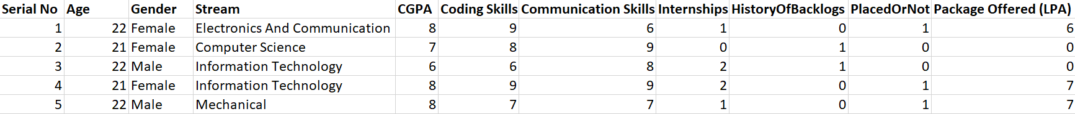
DATASET INSIGHT
AI (2021-2022) Team - 3

Slide 6
DATASET INSIGHT
The Labels in the dataset are :
Placed or Not
Package Offered (LPA)
The Features Used to Predict the Labels are :
Age
Gender
Stream
CGPA
Coding Skills
Communication Skills
Internships
History of Backlogs
AI (2021-2022) Team - 3

Slide 7
MACHINE LEARNING MODELS
Random Forest Classifier Model with criterion Gini index and 5 estimators will be used to predict whether the student will get placed in an organization or not.
Random Forest Regressor Model will be used to Predict the Package Organization will offer if the student gets placed in it based on the same features.
AI (2021-2022) Team - 3

Slide 8
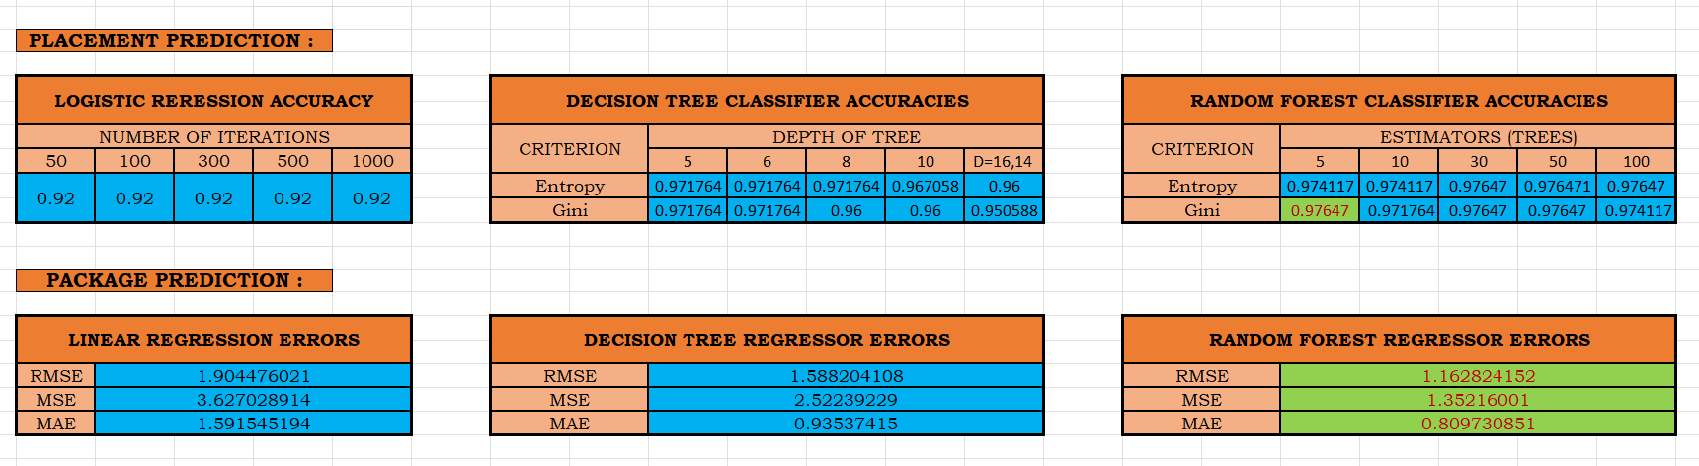
COMPARITIVE RESULTS
AI (2021-2022) Team - 3

Slide 9
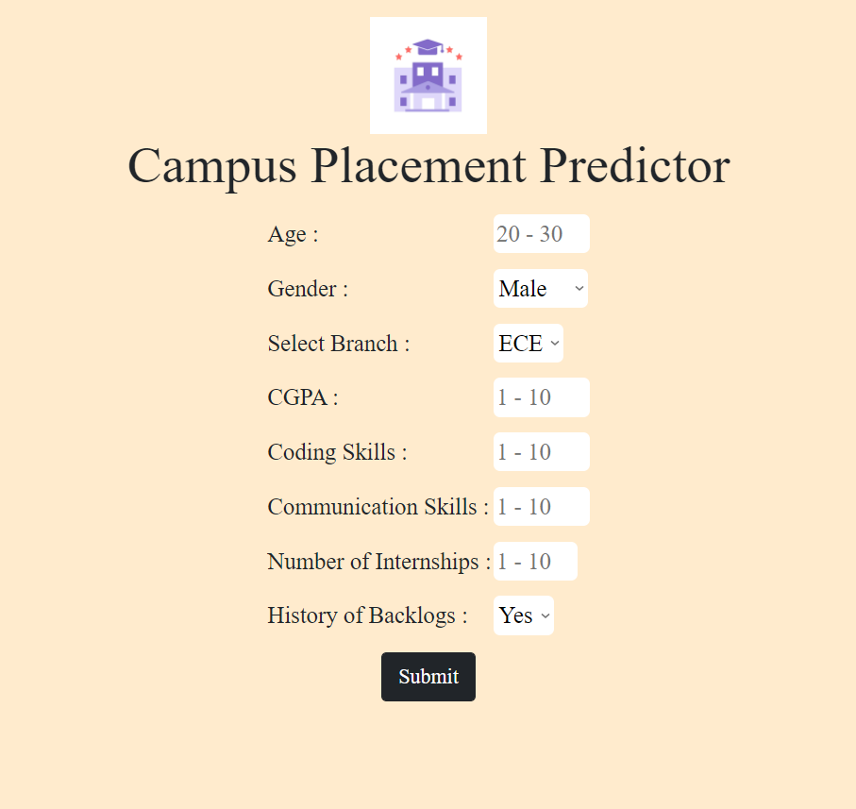
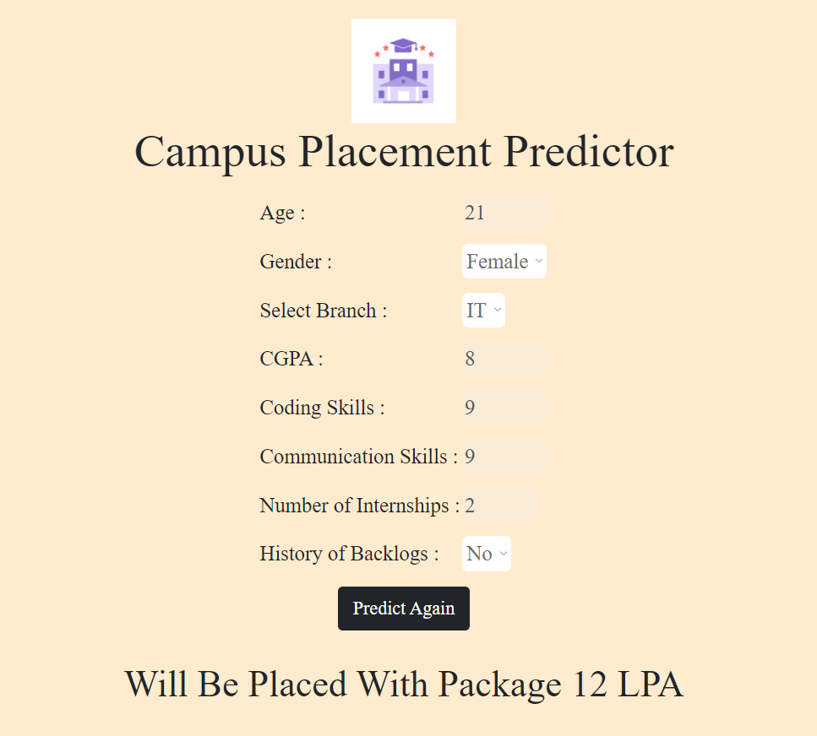
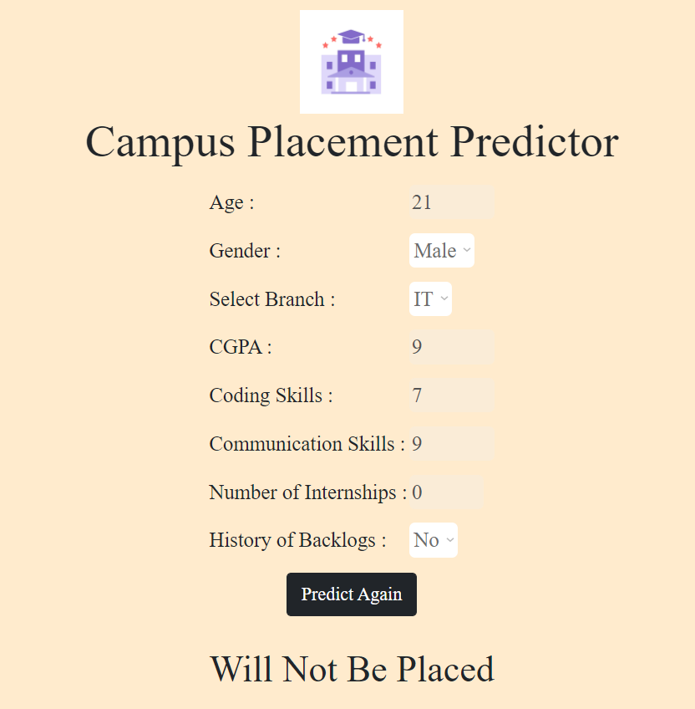
WEB APPLICATION
https://campus-placement-predictor.herokuapp.com
AI (2021-2022) Team - 3

Slide 10
CONCLUSION
we can see that our preferred scoring is around 86% which is given by Random Forest regressor Model for package prediction and 97% for placement prediction using random forest classifier.
This system will also be helpful for development of college as new project skills will be created by student and percentage of placement will be increased overall.

Slide 11
THANK YOU

